Slide 2

your face when you snuck in an internship

Slide 4
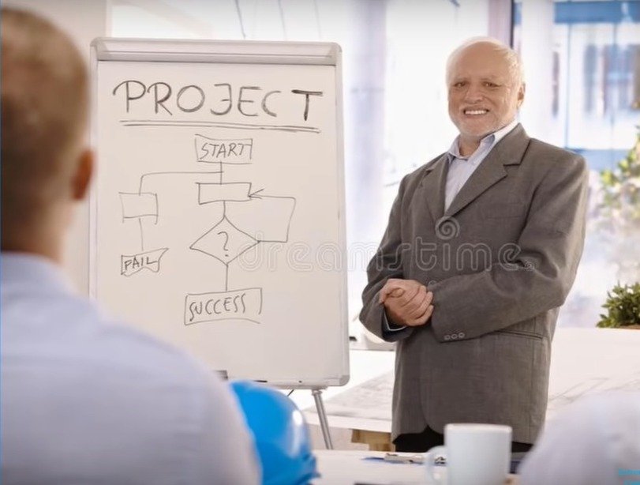

Slide 5

The QA-engineer won’t find errors in your project
if you are QA-engineer

Slide 6

LOGIC..

Slide 7
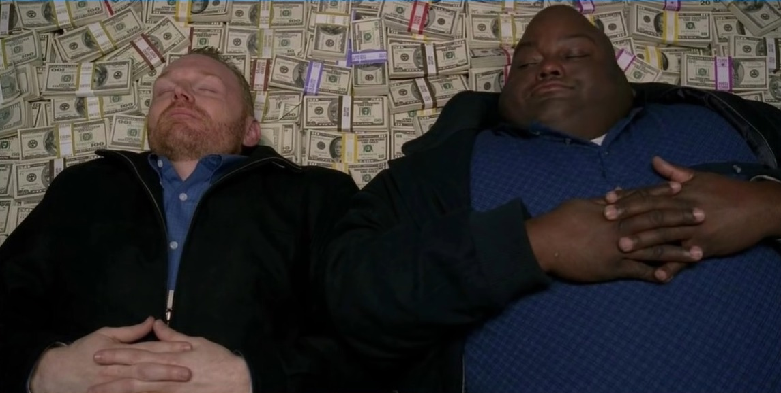
The cherished dream of every(one) businessman

Slide 9
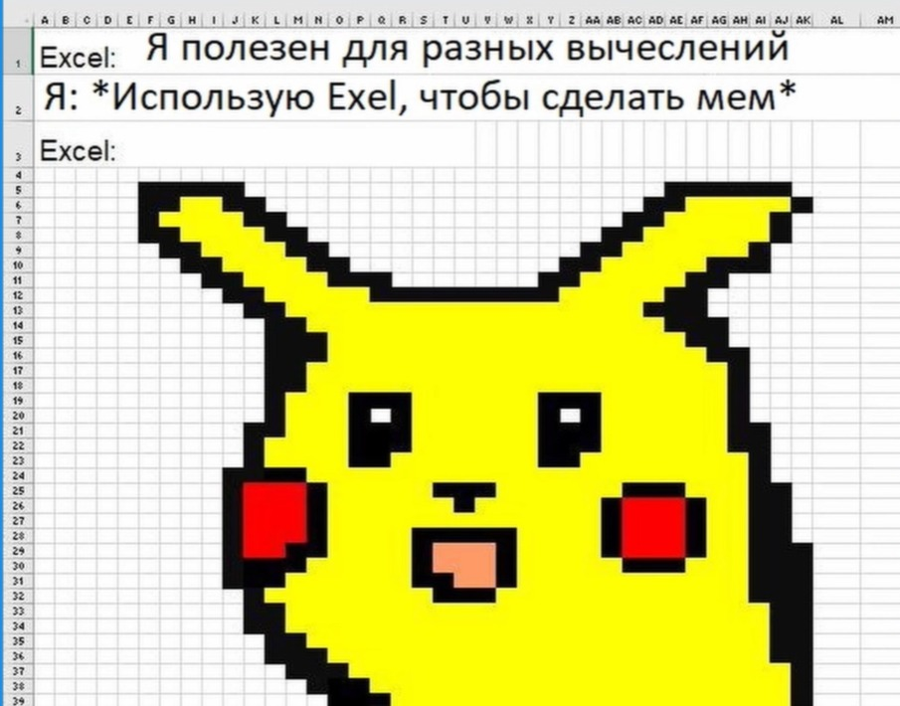
I am useful for different calculations
use Exel to make mem

Slide 11
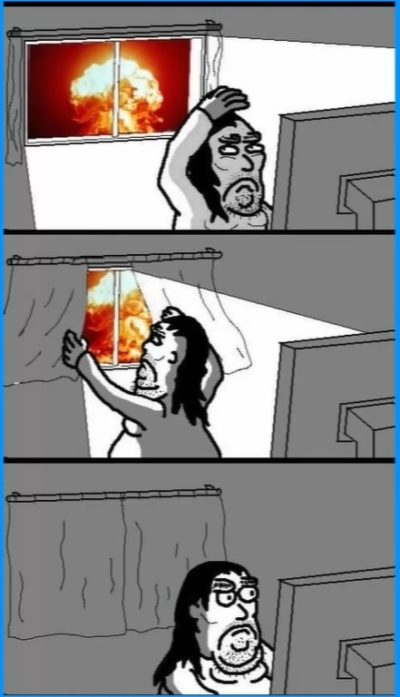

Slide 12


Slide 13


Slide 14


Slide 16


Slide 18

Program!

